Slide 1
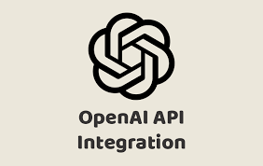
OPENAI API VERSE
MINI PROJECT-2
Submitted By: Submitted To:
Abhishek Shukla (201500024) Ms. Gurpreet Kaur
Divik Singh (201500227)
Tushar Tomar (201500748)

Slide 2
CONTENTS
- INTRODUCTION : What is OPENAI API ?
- PROBLEM STATEMENT : Why This Application ?
- All about OPENAI APIS
- Tool used
- Outputs images
- References
Conclusion
Future work
- Thank you -
Notes:
FRIENDSHUB

Slide 3
What is OPEN AI API ?
OpenAI API is a cloud-based platform that allows developers to access OpenAI's state-of-the-art language models and artificial intelligence technology through a simple API (Application Programming Interface).
Benefits of OPENAI API
The OpenAI API provides developers with a powerful platform to access state-of-the-art language models and artificial intelligence technologies for use in their applications. One of the key benefits of using the OpenAI API is its ability to perform complex natural language processing (NLP) tasks such as language translation, text summarization, and sentiment analysis. This can save developers significant time and resources as they no longer need to build and train their own models from scratch. Additionally, the OpenAI API provides a simple interface for developers to use, supporting several popular programming languages including Python, Java, Ruby, and C#.
Another benefit of the OpenAI API is its ability to handle large volumes of data and perform computations quickly and efficiently in the cloud. This can help developers to scale their applications and handle a large number of requests without having to worry about the underlying infrastructure. The API also supports real-time applications such as chatbots and virtual assistants, enabling developers to build intelligent conversational interfaces for their users.

Slide 4
Why is this website ?
ChatGPT clone and AI image generator are two examples of applications that can be built using the OpenAI API.
A ChatGPT clone is a conversational AI model based on the GPT architecture that is capable of carrying on human-like conversations with users. By using the OpenAI API, developers can train and fine-tune their own language models to create chatbots that can handle a wide range of conversations and interact with users in a natural and engaging way. This can be useful for a variety of applications such as customer service, virtual assistants, and social media engagement.
An AI image generator, on the other hand, is a tool that uses deep learning algorithms to generate images that are realistic and visually appealing. By using the OpenAI API, developers can access pre-trained generative models such as DALL-E to generate custom images based on user input. This can be useful for a variety of applications such as graphic design, art, and content creation.

Slide 5
Introduction to OPEN AI API’s
One of the key benefits of using the OpenAI API is its ability to handle large volumes of data and perform computations quickly and efficiently in the cloud. This allows developers to scale their applications and handle a large number of requests without having to worry about the underlying infrastructure.
Another benefit of the OpenAI API is its ability to continually improve and evolve over time as new research and technology becomes available. This means that developers can be confident that they are using the latest and most advanced AI technology available.

Slide 6
TOOLS USED
HTML : HTML stands for Hyper Text Markup Language. HTML is the standard markup language for creating Web pages. HTML describes the structure of a Web page. HTML consists of a series of elements. HTML elements tell the browser how to display the content.
CSS : Cascading Style Sheets (CSS) is a stylesheet language used to describe the presentation of a document written in HTML or XML (including XML dialects such as SVG, MathML or XHTML). CSS describes how elements should be rendered on screen, on paper, in speech, or on other media.
JS : JavaScript, often abbreviated as JS, is a programming language that is one of the core technologies of the World Wide Web, alongside HTML and CSS.

Slide 7
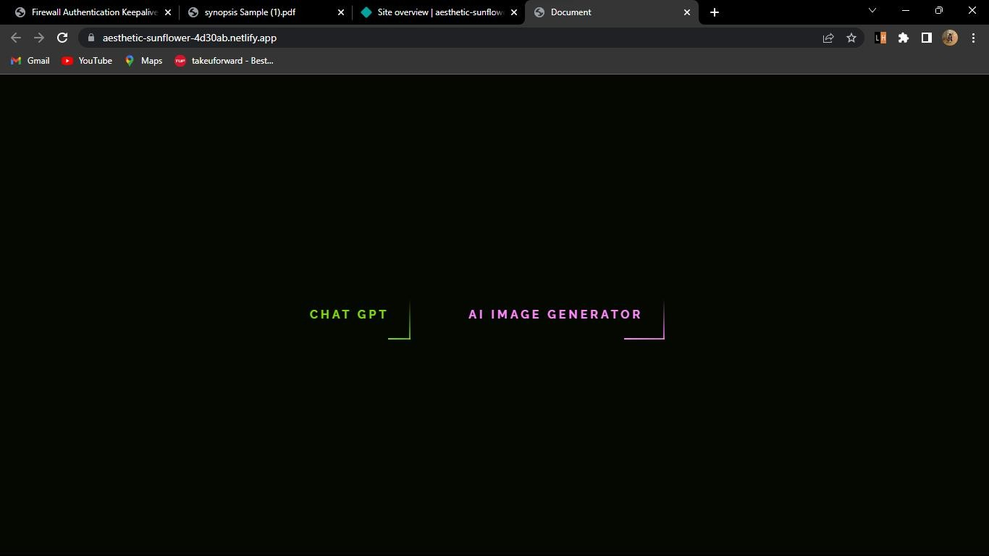
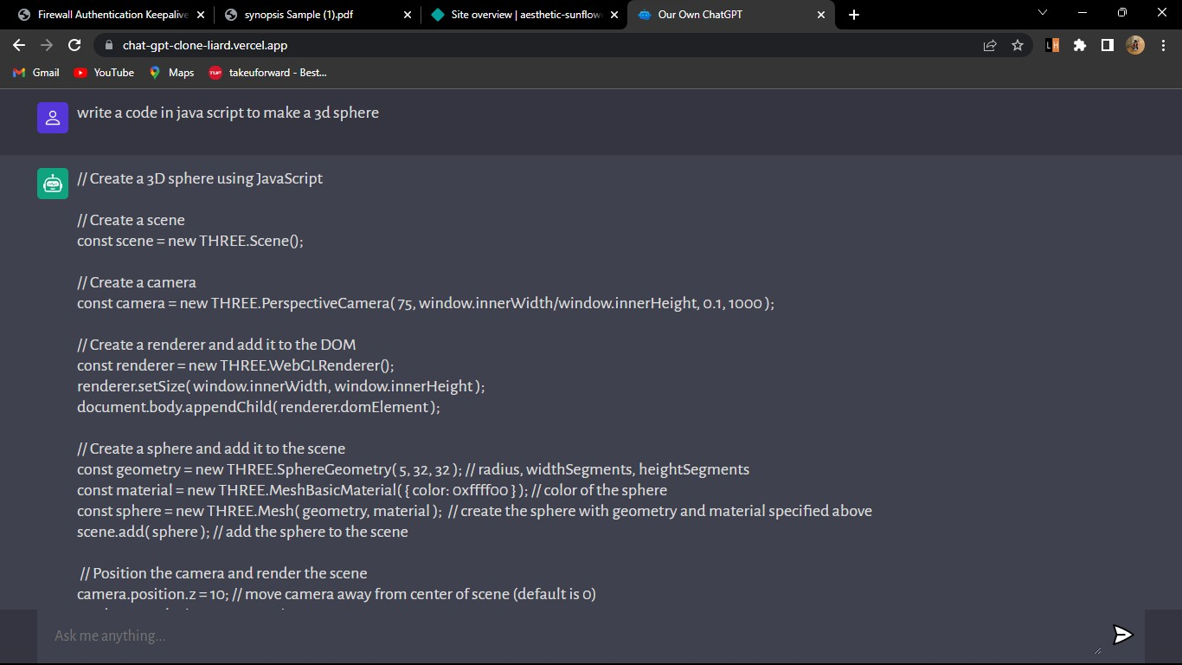
OUTPUT IMAGES

Slide 8
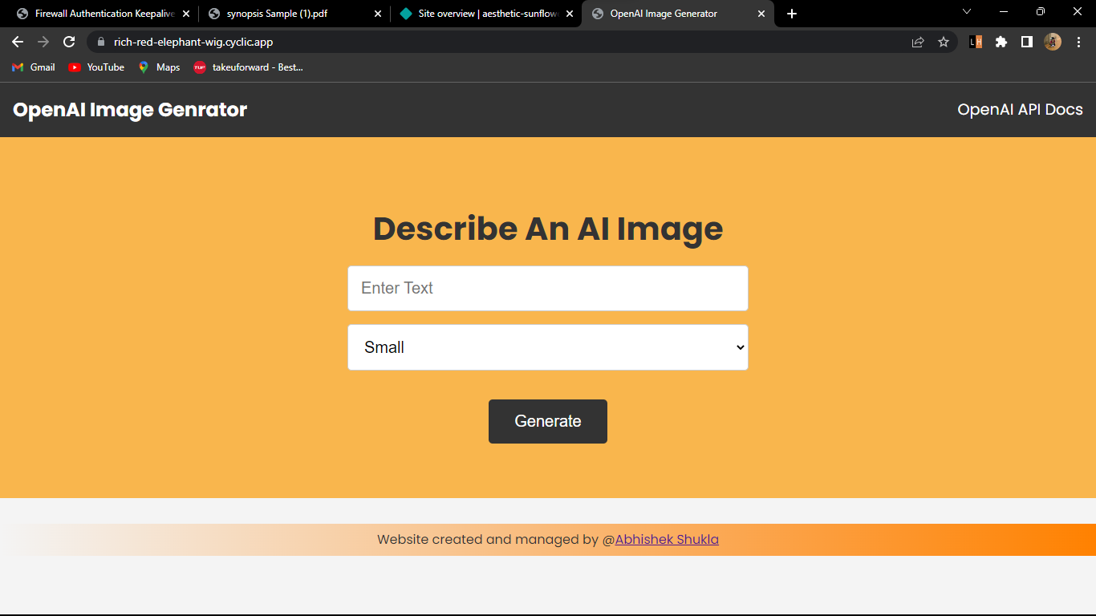
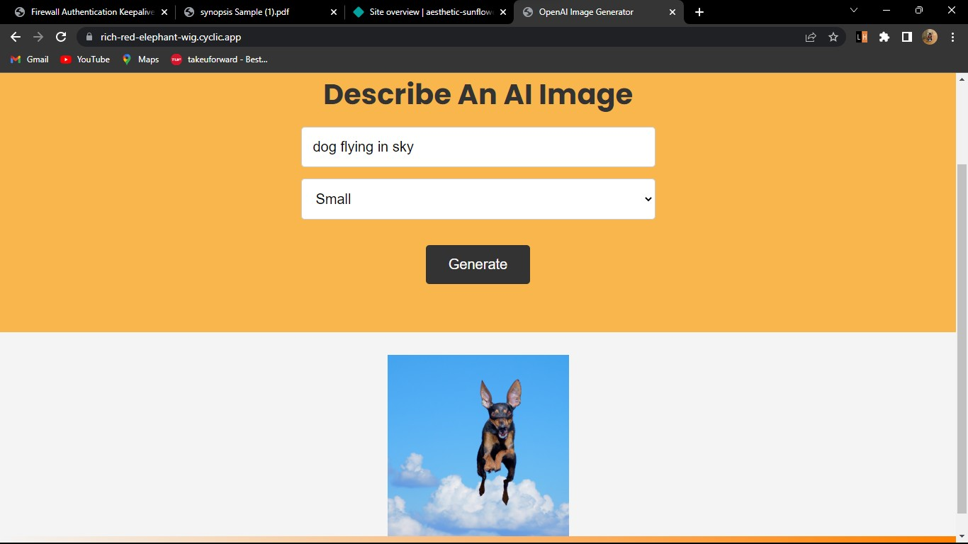

Slide 9
REFERENCES
Books:
- Head First HTML and CSS
A Learner's Guide to Creating Standards- Based Web Pages
Elisabeth Robin
Eric Freeman
﻿﻿- HTML & CSS : design and Build websites
﻿﻿- Learning Web design
- JAVAScript

Slide 10
CONCLUSION
For the ChatGPT clone project, the implementation of the GPT-3.5 architecture has enabled the creation of a highly intelligent and responsive language model. The model can understand natural language and provide relevant responses to various prompts. However, further improvements can be made by fine-tuning the model on specific domains or datasets to improve its accuracy and relevance.
As for the AI image generator project, the use of GANs has enabled the creation of highly realistic and convincing images that can be used for various applications such as product design, marketing, and gaming.

Slide 11
FUTURE WORK
In terms of future work, there are several areas of improvement for both projects. For the ChatGPT clone, the model can be fine-tuned on specific domains such as finance, healthcare, or legal to provide more accurate and relevant responses in those areas. Additionally, incorporating multi-modal inputs such as audio and video can enhance the model's capabilities.
For the AI image generator project, the generator can be improved by incorporating more advanced techniques such as attention mechanisms, and exploring more advanced GAN architectures. Furthermore, developing methods for generating more diverse and varied images can also improve the overall quality of the images.

Slide 12
- THANK YOU ! -

